Slide 1
CSPC 355
Tutorials
Hello World in C

Slide 2

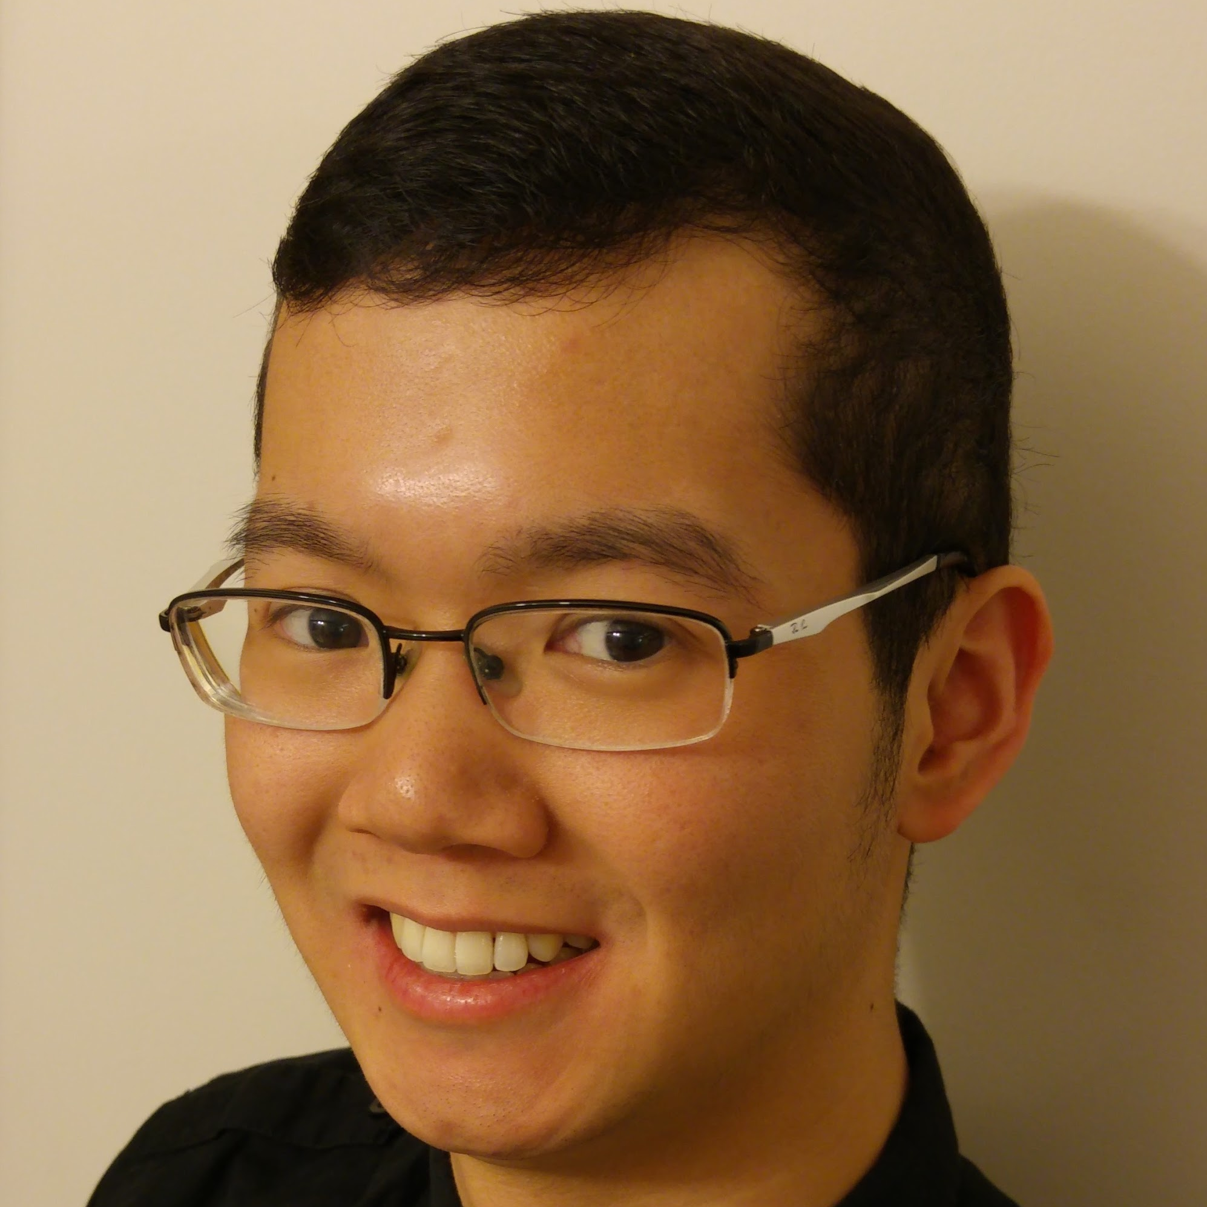
Hello!
I am Kevin Ta
M.Sc in
Human Computer Interaction
Email:
kta@ucalgary.ca

Slide 3
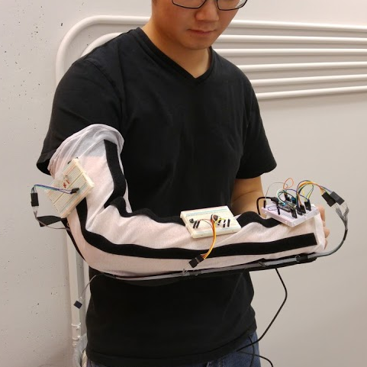
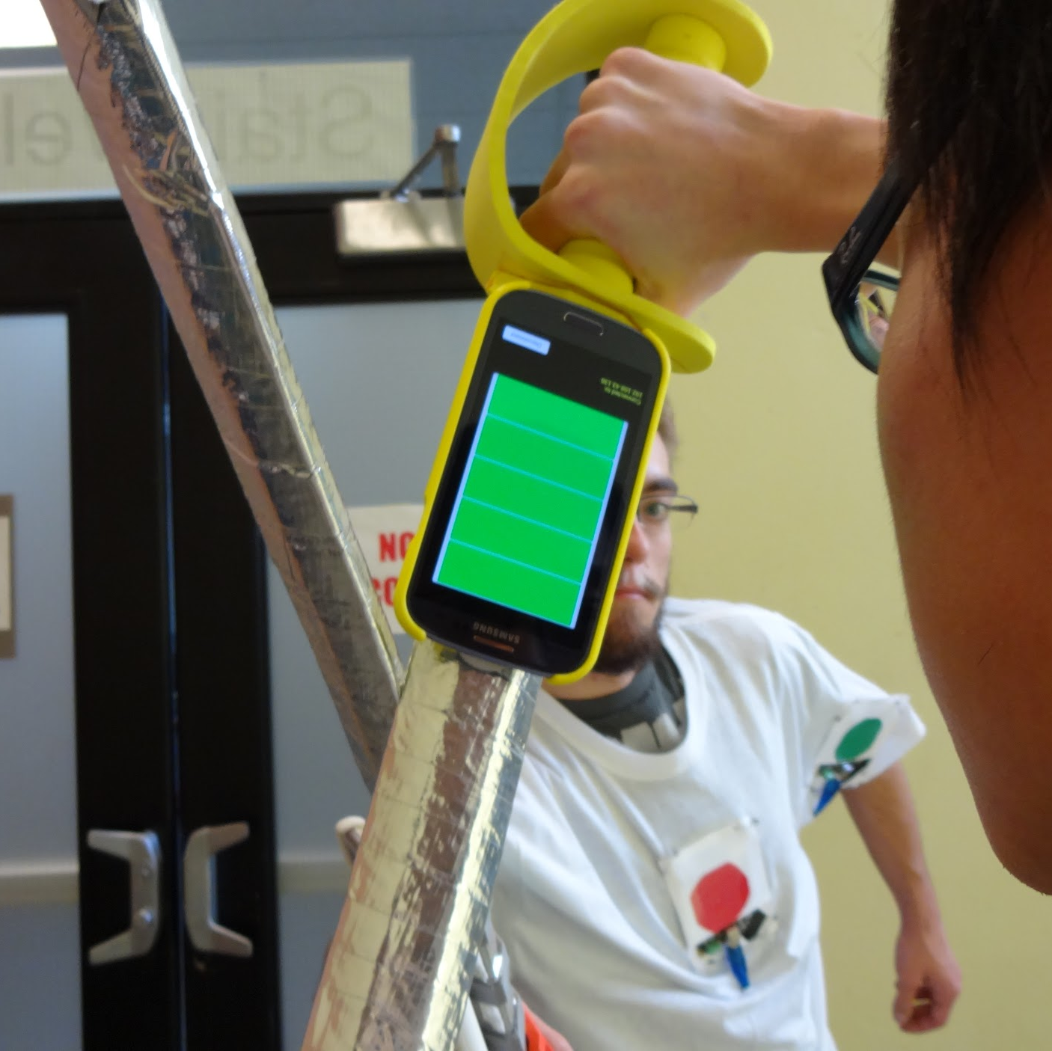
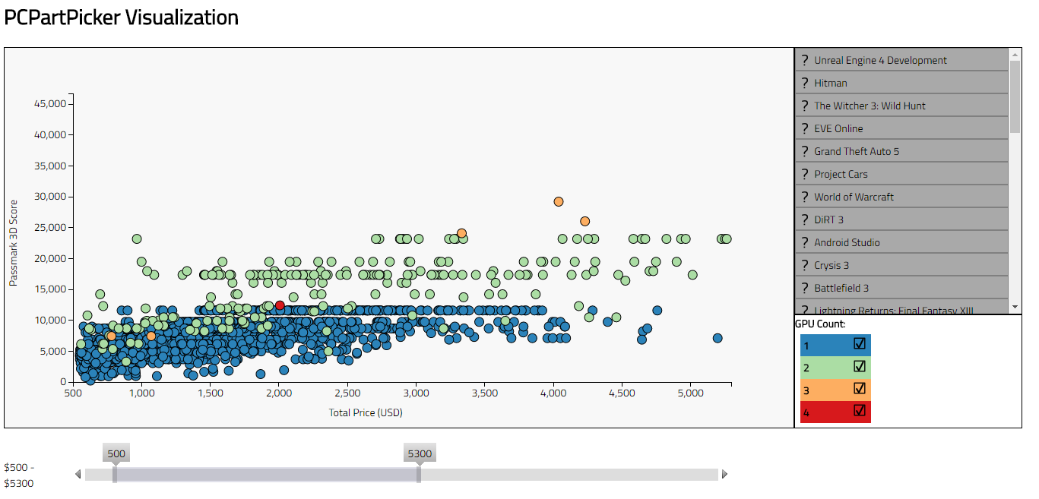
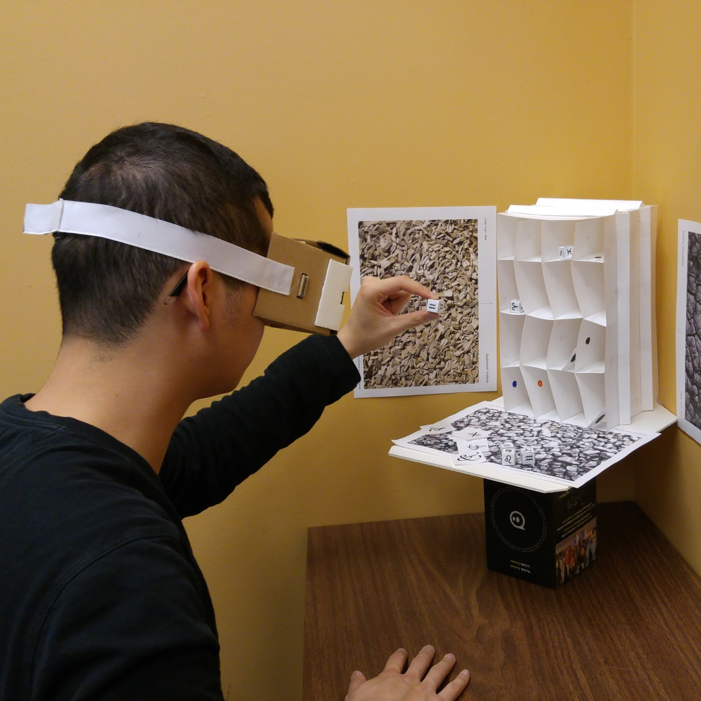
I make stuff

Slide 4
Email Policy
Within 24 hours
Include [CPSC 355] in subject
Ask early around assignment time
Notes:
Ask early, I will try to get back to you.

Slide 5
Office Hours
By Appointment
Email me to make arrangements

Slide 6
Slides
Tutorial website: https://goo.gl/Fnzp4t
Posted sometime after tutorial

Slide 7
Covered Today
Remote Access via SSH
Editing Files Remotely
Hello World in C
Command Line I/O

Slide 8
1.
Remote Access via SSH
Remote Wizardry

Slide 9

Secure Shell (SSH)
Lets you use the terminal on other computers and servers
Login using your CPSC login
Run commands and programs remotely

Slide 10

SSH Clients
Linux
‘ssh’ command on the terminal
Windows
Putty
Bitvise
Windows 10 Bash Shell
Mac OS X
‘ssh’ command on the terminal
Notes:
I recommend getting the portable Putty without install.

Slide 11
SSH
Demo
Notes:
I recommend getting the portable Putty without install.

Slide 12
Servers
School servers:
arm.cpsc.ucalgary.ca
Assignments must compile/run on the ARM servers
csa1, csa2, csa3
More school servers: http://www.ucalgary.ca/cpsc/tech/services/computing_resources
Notes:
I will grade your assignments based on running on the ARM server. They must compile and run on this server when you are handing them in.
Arm.cpsc.ucalgary.ca actually takes you to one of three servers to for load balancing. So therefore they must run on
csa1.cpsc.ucalgary.ca
csa2.cpsc.ucalgary.ca
csa3.cpsc.ucalgary.ca

Slide 13
2.
Editing Files Remotely
Using ‘vim’

Slide 14
Terminal File Editors
Limited to what is installed on the remote machine
CPSC UCalgary’s Servers have:
Nano
Vim
Vi
Emacs

Slide 15
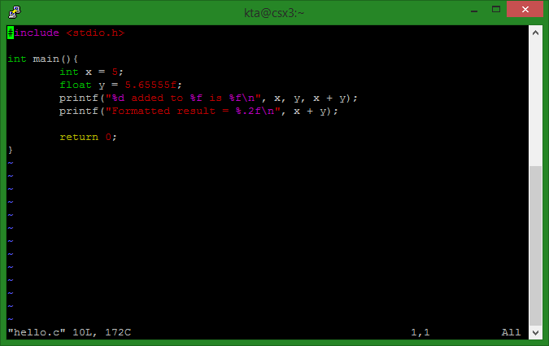
Vim
vim hello.c
Demo

Slide 16
Vim
Access menu
Type ‘:’
Once in the menu
Type ‘write’ to save
Type ‘quit’ to exit
Editing
Press ‘i’ to begin inserting text
Press ESC to stop editing

Slide 17
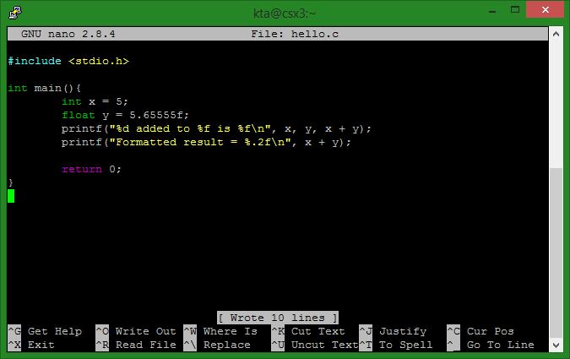
Nano
nano hello.c

Slide 18
But SSH is so Annoying! 😡
Alternatively, write to a file and upload
Must update the file when compiling
Remember, assignments must compile on the arm.cpsc.ucalgary.ca servers
Notes:
Bitvise comes with an SFTP client to upload files

Slide 19
3.
Hello World
In C

Slide 20
Hello World
See page 7 of K&R Textbook
Source code modified (next slide)
Add return 0; to compile for gcc

Slide 21
Hello World
Demo
Notes:
Can print stuff

Slide 22
Compiling with gcc
[kta@csa1 Tutorial 1]$ ls hello.c [kta@csa1 Tutorial 1]$ gcc hello.c -o hello [kta@csa1 Tutorial 1]$ ./hello 5 added to 5.655550 is 10.655550 Formatting the result is =10.66 [kta@csa1 Tutorial 1]$
Notes:
Compile with ‘gcc hello.c -o hello’, makes output file ‘hello’
Run with ‘./hello’

Slide 23
printf()
Print format
printf(string, args…)
String
String to print with format characters
Args
Arguments for formatting, optional
See reference

Slide 24
printf() Formatting Examples
Print 2 decimal points (rounded)
printf("%1.2f\n", 12.666666f);
Prints: 12.67
Print as hex
printf("%x\n", 9005);
Prints: 232d
See reference
Notes:
See reference for more details

Slide 25
printf()
Demo

Slide 26
4.
Command Line I/O
Getting input

Slide 27
Hello World: Forever
Let’s modify our program to accept input
What it should do:
“./hello”
Prompts the user for a number
When the user hits enter, the program prints “Hello world” 7 times
Bonus: if less than zero, loop forever

Slide 28
Hello World: Forever
Demo

Slide 29
scanf()
Takes input from the command line
scanf(format, &args...)
Format
Format of the input you want
&args
Variable to store as a pointer
See Reference
Notes:
Kinda like Scanner from Java

Slide 30
Additional Resources
Standard Library Reference: https://www.tutorialspoint.com/c_standard_library/

Slide 31
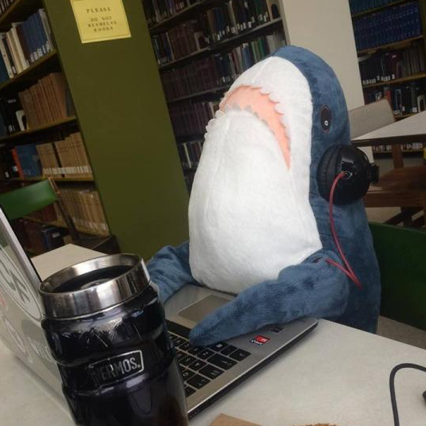
Thanks!
Any questions?
Email:
kta@ucalgary.ca
Notes:
Slides from Slides Carnival

